Slide 1

Chapter 5
A Game Framework:
Target the player game
Game Development 1.1
Denis McCarthy
E-mail: demccarthy@ait.ie
Room: U302

Slide 2
Framework
From now on we are going to use a standard framework for the games we create so that they all have:
  Start and end screens that work in the same way
  A controller object that will:
    take care of when we lose lives in the game
    hold cheat commands for switching levels, more lives etc
Game Development 1.1
Denis McCarthy

Slide 3
Framework (cont)
Title screen:
  that displays the name of the game and has buttons to:
    start a new game
    load a saved game
    show help*
    display the high-score table*
    quit the game
  Game developers normally use the term front-end to refer to the part of the game that allows the player to make selections like this.
  This screen will also be responsible for starting the background music, and for initialising any other game setting like score etc.
  * Since the Help/Highscore functionality is different in GM Studio, we will incorporate a fully functioning help/highscore mechanism in our next game.

Slide 4
Framework (cont)
The actual game:
  in our framework template we will just create a blank room
Back-end (completion screen)
  The end of game screen that is shown when the game has been completed
  This displays a congratulatory message
  after which the game returns to the front end
Game Development 1.1
Denis McCarthy

Slide 5
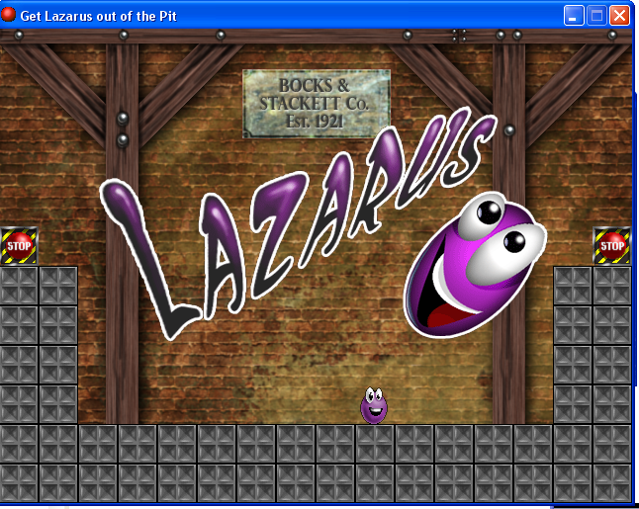
Lazarus
Lazarus has been abducted by the Blob Mob, who are intent on bringing this harmless creature to a sticky end. They have imprisoned him at the Blobfather's (sorry) factory, where they are trying to squish him under a pile of heavy boxes. However, they have not accounted for Lazarus' quick thinking, as the boxes can be used to build a stairway up to the power button that halts the machinery. Do you have the reactions needed to help Lazarus build a way up, or will the evil mob claim one more innocent victim?
Game Development 1.1
Denis McCarthy

Slide 6
Game Resources
All resources needed for this game are stored on moodle under Lab resources Lazarus game.
Download all files and store in a directory
  E.g. denis\lazarus
Game Development 1.1
Denis McCarthy
Notes:
Show moodle image

Slide 7
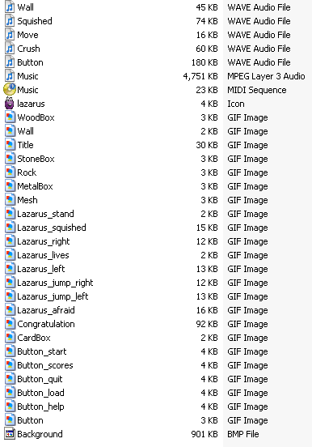
Game Resources
Sounds
icon
Sprites
Background
Game Development 1.1
Denis McCarthy

Slide 8
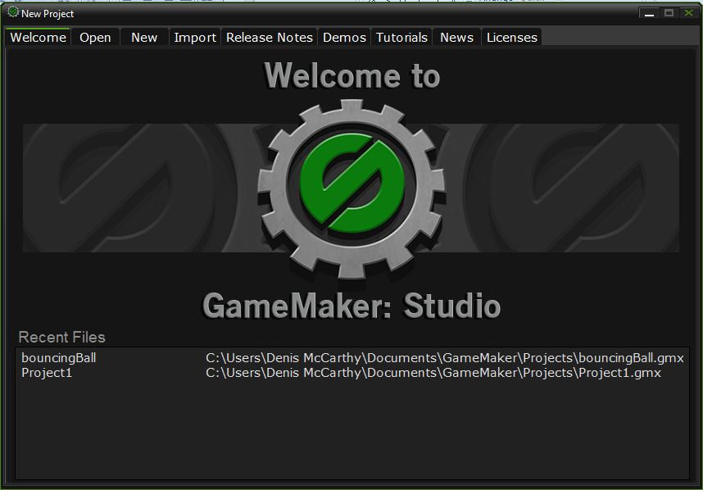
Start Game Maker
Game Development 1.1
Denis McCarthy

Slide 9
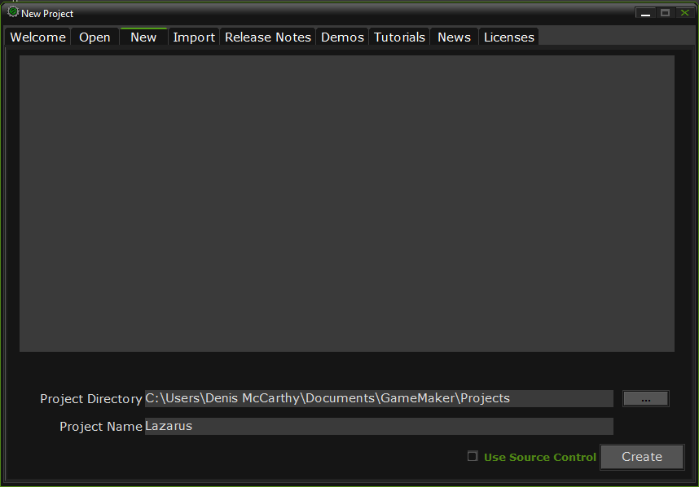
Create a new project
Call the project Lazarus
And click on the Create button.
Game Development 1.1
Denis McCarthy

Slide 10
The Front-End
Commercial games often have developers who devote all their time to creating the front-end for a game.
Ours won’t be that complicated: all we need is:
  background image
  a title sprite
  several button sprites
  and some background music
Note: For the game that we will be creating I will give you the resources needed. All you need to do is change the template to reflect those resources for any other game we create, or that you create yourself . Our next game (a platform game) will have the complete framework including a highscore table.
Game Development 1.1
Denis McCarthy

Slide 11
Creating the front-end
Create a new sprite called sprite_title using Title.gif
Create a new sprite called sprite_lazarus_lives using Lazarus_lives.gif
Create the five button sprites
  sprite_button_start
  sprite_button_load
  sprite_button_help *
  sprite_button_scores*
  sprite_button_quit
  using the appropriate files from the same directory. Do not remove the background when loading these sprites.
Create a new background called background_main using Background.bmp
* For this game these buttons will have no functionality behind them.

Slide 12
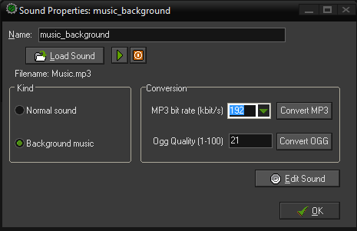
Adding Music
Select Create Sound from the Resources menu.
Call the background music music_background and click on the Load Sound button and choose the file Music.mp3.
Click OK to close the Sound Properties form.

Slide 13
Creating the front-end (cont)
This gives us all the resources we need for creating the front end, so now we can define objects for it. We’ll start with the object that displays the title sprite. We’ll also create a controller object to take care of the initial in game data (lives, score etc)
Create a new object called object_title and give it the title sprite.
No more information is needed for this object
Create a new object called object_controller_start, this has no sprite associated with it.
Add a Create event to the object and include a Set Score action to set Score to 0.
Include a Set Lives action to set lives to 3.
Add a Set Caption to don’t show for all properties, as we will be displaying custom made lives and scores.
Game Development 1.1
Denis McCarthy

Slide 14
Creating the front-end (cont)
Add an Other, Game Start event and include the Play Sound action in it. Select the background music and set the Loop to true so that the music plays throughout the game.
Click on OK to close the properties form.
Creating button object resources for the front end
Create a new object called object_button_start and give it the button start sprite.
Add a Mouse, Left Pressed event to the object and include the Next Room action. The Left Pressed event happens when the user clicks on an instance’s screen position with the left mouse button.
Click on OK to close the properties form.
Game Development 1.1
Denis McCarthy

Slide 15
Creating the front-end (cont)
Create a new object called object_button_load and give it the button load sprite.
Add a Mouse, Left Pressed event to the object and include the Load Game action. File Name must be the same name as the file that we used to save the game, so its easier to leave this as the default setting.
Click on OK to close the properties form.
Create a new object called object_button_help and give it the button help sprite.
For this game we will leave this blank, in our next game a fully functioning help section and will be given to you in a framework.
Click on OK to close the properties form.
Game Development 1.1
Denis McCarthy

Slide 16
Creating the front-end (cont)
Create a new object called object_button_scores and give it the button scores sprite.
For this game we will leave this blank, in our next game a fully functioning highscore table will be given to you in a framework.
Click on OK to close the properties form.
Create a new object called object_button_quit and give it the button quit sprite.
Add a Mouse, Left Pressed event to the object and include the End Game action.
Click on OK to close the properties form.
This gives us all the objects we need. now we need to create a room to put them in that acts as the front-end itself.
Game Development 1.1
Denis McCarthy

Slide 17
Creating the front-end room
Create a new room resource called menu_room. Scale the room window so that you can see as much of the room as possible (preferably all of it).
Switch to the backgrounds tab. Click on the menu icon to the right of where it says <no background> and select the background from the pop-up menu.
Next switch to the objects tab. Place one instance of each of the button objects along the bottom of the room (or somewhere else if you prefer. A logical order would be Start, Load, Help, Scores and Quit.
Select the controller start object and place it anywhere in the room.
Select the title object and position it in the centre of the room Your room should now look like the next slide.
Game Development 1.1
Denis McCarthy

Slide 18
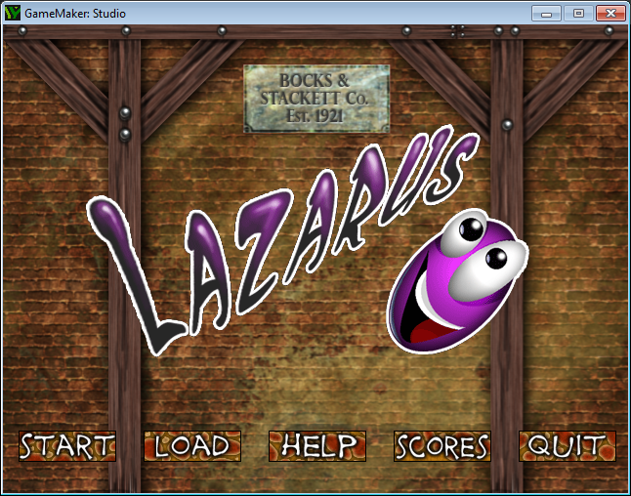
Front-end
Game Development 1.1
Denis McCarthy

Slide 19
Test game to date
You might want to test the framework now to check that it works correctly.
An error message will appear if you click on the start button, but that’s fine as there are no rooms to go to yet in the game.
Likewise the load button will not do anything as there are no saved games to load.
The help and scores will do nothing in this game.
The quit button should work correctly.
Game Development 1.1
Denis McCarthy

Slide 20
The Completion Screen
The completion screen will contain a image displaying congratulations on it. And adds 1000 to the players score (bonus for completing the game).
There will then be a short pause.
After this, the player returns to the opening screen (Front-end).
To achieve this, we’re going to use new kinds of events and actions called alarms. Alarm actions work like a countdown for triggering alarm events. Alarm actions are given an amount of time to wait, and an alarm event is executed at the moment the time runs out. Like other places in GM time is measured in steps, so for each alarm action you indicate how many steps there should be before the alarm event takes place.
Each instance of an object can have up to 12 alarms that can be used to make things happens at set points in the future.
Game Development 1.1
Denis McCarthy

Slide 21
The Completion Screen (cont)
Create a new sprite called sprite_congrats using the file Congratulations.gif remember to remove the background.
Create a new object called object_congrats and give it the congratulations sprite.
Add a Create even and include the Set Alarm action. Set Number of Steps to 120 to create a delay of 4 seconds. Leave In Alarm No set to Alarm 0.
Include a Set Score action below the alarm using a New Score of 1000, and enable the Relative property so that the score is added on.
Add an Alarm, Alarm 0 event. This is the event that will happen 4 seconds after the alarm action is executed.
Include the Different Room action and select the menu room.
Click OK to close the object properties form.
Game Development 1.1
Denis McCarthy

Slide 22
Completion Screen Room
Create a new room called room_completed and give it an appropriate caption.
Switch to the backgrounds tab. Click on the menu icon to the right of where it says <no background> and select the background from the pop-up menu.
Switch to the objects tab. Select the congrats object and position it in the top-left corner of the room.
Click on the green check mark at the top left to close the room properties.
Game Development 1.1
Denis McCarthy

Slide 23
Time to test again
It is time to test your work and try all the buttons again.
Playing the game should now take you to the closing screen (you’ve finished all the levels as there are none!)
If any of this isn’t working correctly, then carefully check that you’ve followed the instructions carefully.
We have one last object to create to finish the frame work, and this is another controller object that will control the main game.
Game Development 1.1
Denis McCarthy

Slide 24
Main Controller object
Create a new object called object_controller_main, this has no sprite associated with it.
Add a Keyboard, N-Key event to the object and include a Next Room action to it.
Add a Keyboard, P-Key event to the object and include a Previous Room action to it.
Add a Keyboard, L-Key event to the object and include a Set Lives action to it that increase the lives by 1.
Add a Keyboard, R-Key event to the object and include a Restart Room action to it.
All of these events are effectively cheats and should be removed when the game is completed.
Game Development 1.1
Denis McCarthy

Slide 25
Main Controller object (cont)
Add an Other, No More Lives event to the object.
Include the Different Room action and select the menu room.
We will need a font resource called font_score that has properties Arial, 14 and Bold selected for it.
Add an Draw event to the object and include a Set Font action with the font score selected.
Add a Set Color action and set the colour to red.
Add a Draw Score action and set x and y to 450 and 4 respectively.
Add a Draw Text action and set the text to “Lives:” and set x and y to 8 and 4 respectively.
Add a Draw Life Images action and set the image to the sprite Lazarus lives image and set x and y to 70 and 4 respectively.
Game Development 1.1
Denis McCarthy

Slide 26
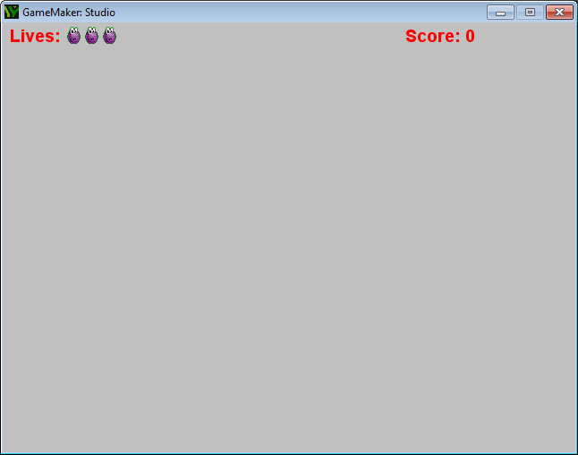
mini test
You could test the main controller object in a blank room and it would display the following.

Slide 27
Framework complete
Our framework is now complete.
We will use this type of framework (with different graphics) for most of our remaining games.
In our next game we will introduce a high score table and help screen. That framework will be based on these notes.
I won’t be going through the steps again in so much detail, so make sure that you understand it well before continuing.
Otherwise, you can either:
  refer back to these notes
  or simply load each game with the framework already made to save yourself some work.
  To do this save your current file as “Framework”
  Then for each game all you need to do is change the images and music.
Firstly we will create all the sound resource need for our game.

Slide 28
sound resources
Create the five sound resources
  sound_wall
  sound_squished
  sound_move
  sound_crush
  sound_button
  using the appropriate files from the same directory where you
  downloaded the rest of the files.
We will you these sounds throughout the rest of the notes for the game Lazarus.
Game Development 1.1
Denis McCarthy

Slide 29
Lazarus
Now that out framework is complete, lets get started on the fun part: developing our game.
Our first task is to create the Lazarus character.
We’ll give him comical animations for when he’s moving, jumping and being squished to add to the appeal of the game.
This will require a number of different sprites and several Lazarus objects as well.
Using several objects helps us to separate the different animations of Lazarus in a simple way.
Game Development 1.1
Denis McCarthy

Slide 30
Animated Character
The animations for Lazarus have been designed around the size of boxes within the game.
All the boxes are exactly 40x40 pixels in size.
Animations that show Lazarus jumping from one box to the next need to be as tall as two boxes (80x80 pixels).
This means we will be working with sprites of different sizes, and have to think carefully about where to place the origin of each sprite so they match up correctly.
Remember that GM acts as if it is holding each sprite by its origin as it moves around the screen; so all the origins need to be as the same position relative to Lazarus – regardless the size of the sprite.
This should begin to make sense as you complete the following steps.
Game Development 1.1
Denis McCarthy

Slide 31
Lazarus Sprite Resources
Create a new sprite called sprite_laz_stand using Lazarus_stand.gif. This sprite is 40x40 pixels and shows Lazarus in his “normal” position. Remember that the origin for sprites defaults to the top-left corner (X and Y both set to 0). We’ll leave this where it is and make sure that the origins of all the other sprites match up with this position.
Create another new sprite called sprite_laz_right using Lazarus_right.gif. This sprite is 80x80 pixels and shows Lazarus jumping 40 pixels to the right (use blue arrows to preview the animation). As usual, the origin has defaulted to the top left corner of the sprite, but this is further above Lazarus's head than in the last sprite. To match up with previous one, we need to move the origin down by 40 pixels, so set the Y value to 40.
Game Development 1.1
Denis McCarthy

Slide 32
Lazarus Sprite Resources (cont)
Create a sprite_laz_jump_right in exactly the same way using Lazarus_jump_right.gif. (with an X value of 0 and a Y value of 40).
Create another new sprite called sprite_laz_left using Lazarus_left.gif. This sprite is 80x80 pixels and shows Lazarus jumping 40 pixels to the left, but this time Lazarus starts on the bottom-right side of the sprite. This means we need to move the origin 40 pixels down and 40 pixels right to place it at the same relative position as before. Set both X and Y values to 40.
Create a sprite_laz_jump_left in exactly the same way using Lazarus_jump_left.gif. (with an X value of 40 and a Y value of 40).
Create two more sprites sprite_laz_afraid and sprite_laz_squished using Lazarus_afraid.gif and Lazarus_squished.gif. These are 40x40 pixels so there’s no need to change the origin.
Game Development 1.1
Denis McCarthy

Slide 33
Lazarus Sprite Resources (cont)
These are all the sprites we need for Lazarus, so our next step is to make some objects for him.
The main object will be the “normal” standing Lazarus.
This is the most important one as it will react to the player’s keyboard input.
The other images are only there to play the different animations, after which they themselves turn back into the standing Lazarus..
They will also move Lazarus t a new position that corresponds to the final frame of the animation.
Game Development 1.1
Denis McCarthy

Slide 34
Lazarus Objects
We have a bit of a chicken-and-egg situation here.
The “normal object” will need actions to turn it into “animating objects” (which don’t exist yet)
And the “animating objects” will need actions to turn them into “normal objects” (which also don’t exist yet).
So which objects do we create first?
The answer is we create the “normal object” but come back to creating its events and actions after we have created the “animating objects”, crafty, eh?
Game Development 1.1
Denis McCarthy

Slide 35
Lazarus objects (cont)
Create a new object called object_laz_stand and give it the standing Lazarus sprite.
Click OK to close the properties form (we will come back to it later).
Create a new object called object_laz_right and give it the sprite that hops one box horizontally to the right (sprite_laz_right ).
Add an Other, Animation End event to the object. This event happens when a sprite reaches the last sub-image in its animation.
Add a Jump to Position action in this event. Set X to 40 and Y to 0 and make sure that the relative option is enabled. As the boxes are all 40x40 pixels, this will move Lazarus exactly one box to the right at the end of the animation.
Also include the Change instance action below this and select object_laz_stand as the object to change back into.
Click on OK to close the object properties form
Game Development 1.1
Denis McCarthy

Slide 36
Lazarus objects (cont)
Create another object called object_laz_left and give it the sprite that hops one box horizontally to the left (sprite_laz_left ). Repeat the same process as before (steps 4 – 7), but set X to -40 for the Jump to Position action.
Create another object called object_laz_jump_right and give it the sprite that hops one box diagonally to the right (sprite_laz_jump_right ). Repeat the same process as before (steps 4 – 7), but set X to 40 and Y to -40 for the Jump to Position action.
Create another object called object_laz_jump_left and give it the sprite that hops one box diagonally to the right (sprite_laz_jump_left ). Repeat the same process as before (steps 4 – 7), but set X to -40 and Y to -40 for the Jump to Position action
Game Development 1.1
Denis McCarthy

Slide 37
Other Lazarus objects
We may as well get squished Lazarus object out of the way now too, even though we won’t need it for a while.
When the instance is created we will play a squishing sound.
Once its gruesome animation finishes, this object will display a message to tell the player that they’ve been squished.
This isn’t because we think the player is too stupid to notice, but it provides a useful pause before starting the level again. (That’s if we have any lives left.)
Game Development 1.1
Denis McCarthy

Slide 38
Squished Lazarus Object
Create a new object called object_laz_squished and give it the squished Lazarus sprite.
Add an Create event and include the Play Sound action in it. Select the squished sound and set the Loop to false so that the music only plays once.
Add an Other, Animation End event to the object. Add a Display Message action in it.
Type something like “YOU’RE HISTORY!# Better luck next time!” into the message properties. Note that putting the # symbol in the middle of the message will start a new line from this point.
Decrease the number of lives by 1.
Check whether the number of lives is larger than 0, if so include a Restart Room action and press OK to close the object properties form
Game Development 1.1
Denis McCarthy

Slide 39
Object_laz_stand
Now we have these animation objects in place, we can continue making the main standing Lazarus object we started earlier.
One of its main jobs is to change into the appropriate animating object when the player presses a key.
The appropriate object depends on whether Lazarus is standing next to any boxes.
We’ll use a conditional collision action to help GM work this out for us.
Game Development 1.1
Denis McCarthy

Slide 40
Right key event
Reopen the properties form for the object_laz_stand object by double clicking it in the resource list.
We’ll start by creating actions to handle moving to the right. Add a Key Press, <Right> event and include the Check Collision action in it (control tab).
This action allows us to check that there would be a collision if we moved this instance to a particular position on screen. We need to make sure that Lazarus is on solid ground before allowing him to move, as he shouldn’t be able to jump when he is standing on thin air!. To check that this is the case, we set X to 0 and Y to 8 (slightly below his current position), and enable the Relative option.
Note: Conditional collision actions have an Objects option, which allows us to choose between checking for collisions with all objects or only ones marked as solid. We’re leaving this set to only solid, so we need to remember to set the Solid property later when we create the box objects.
Game Development 1.1
Denis McCarthy

Slide 41
Right key event (cont)
All of the remaining actions in this event depend on the previous condition (they only need to be called if the condition is true). Consequently, we’ll need to include them all between Start Block and End Block actions. Include the Start Block action now.
Now include the Check Empty conditional action. This conditional action is the opposite of the last one, it checks that there wouldn’t be a collision if we moved to a particular position on the screen. So to check that the space to the right of Lazarus is free, set X to 40 (the width of a box), set Y to 0, and enable the Relative option.
Include the Change Instance action (main1 tab) and select the object_laz_right. Select yes to Perform Events. This means that the Create event of the object we’re turning into will get called (which is important later when we add sound effects).
Game Development 1.1
Denis McCarthy

Slide 42
Right key event (cont)
Note: The Perform Events option controls whether the Destroy event of the current object and the Create event of the new object should be called. This isn’t usually necessary so it does not call them by default.
Next include the Else action (control tab), more about this in a while.
Include another Check Empty conditional action directly after the Else. This is to verify that there are no boxes diagonally, up and to the right of Lazarus. Set X to 40 and Y to -40 (moving up the way, the Y value decreases), and enable the Relative option.
Next include the Change Instance action and select the object_laz_jump_right object. Select yes to Perform Events.
Finally include the End Block action to conclude the actions that should be performed if Lazarus is on solid ground. The list of actions should look like the next slide.
Game Development 1.1
Denis McCarthy

Slide 43
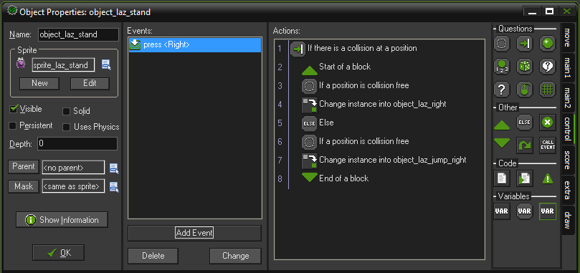
Right key event (cont)
Game Development 1.1
Denis McCarthy

Slide 44
Else action
This is the first time we’ve used the Else action, it is often used alongside conditional actions in this way.
On its own, a conditional action only allows you to specify actions that should be performed whenever the condition is true.
However in combination with Else, you can specify different actions to be performed if that same condition is NOT true.
This has many uses, but in this situation it allows us to ask questions like:
  Is there solid ground beneath Lazarus’s feet? Yes. Well, is there a free
  space to the right of Lazarus? No – there’s a box in the way/ Okay, well, is
  there a free space on top of that box then? Yes – lets jump on top of it.
Game Development 1.1
Denis McCarthy

Slide 45
Else action (cont)
This is just one possible outcome, but our actions provide outcomes for four different situations.
  Not moving when falling through the air
  Moving horizontally to the right when no boxes are in the way
  Jumping diagonally to the right when a single box is in the way
  Doing nothing at all when more than one box is in the way.
You can think of this action list as reading something like this:
  If the position below has something solid in it, then read the next sentence.
  If the position to the right is collision free, then change into object
  object_laz_right; else, if the position diagonally right is collision free, then
  change into object object_laz_jump_right.
Game Development 1.1
Denis McCarthy

Slide 46
Else action (cont)
Before continuing, go through the actions step by step in your head and try to end up with each of these different actions. When you’re happy that this makes sense, we’ll move on and do the same thing for the left arrow key.
Note: Like other conditional actions, the Else action can be used with or without blocks. If blocks are not used, then the Else only affects the action that immediately follows it.
Game Development 1.1
Denis McCarthy

Slide 47
Left key event
Add a Key Press, <Left> event and include the Check Collision action in it (control tab). Set X to 0 and Y to 8 and enable the Relative option.
Include the Start Block action.
Include the Check Empty conditional action, with X set to -40 , Y set to 0, and enable the Relative option (this checks left).
Next include the Change Instance action (main1 tab) and select the object_laz_left. Choose yes to Perform Events.
Next include the Else action (control tab).
Include another Check Empty conditional action with X set to -40 and Y set to -40 and enable the Relative option.
Include the Change Instance action and select the object_laz_jump_left object. Select yes to Perform Events.
Finally include the End Block action to finish the block of actions.
Game Development 1.1
Denis McCarthy

Slide 48
Falling Lazarus
Although out keyboard events stop Lazarus from jumping in mid-air, there aren’t any events to make him fall down to the ground when he is.
We’ll get GM to test for this in a Step event so that it is continually checking to see if he should be falling.
However, we need to think carefully about how far he should fall in each step.
The amount of movement in each step will determine how fast he falls, but it will make our job much simpler if we also choose a number that divides exactly into 40 (the height of the boxes).
Can you think why?
Game Development 1.1
Denis McCarthy

Slide 49
Falling Lazarus (cont)
Lets imagine that we chose a number that doesn’t divide exactly into 40, like 12.
Lazarus would have fallen 12 pixels after 1 step, 24 pixels after 2 steps, 36 pixels after 3 steps and 48 pixels after 4.
At no stage has Lazarus fallen the exact 40 pixels needed to fall the height of one box, he is either:
  4 pixels too high (at 36 pixels)
  Or 8 pixels too low (at 48 pixels)
This means he would either end up floating above boxes, or jammed someway into them!
Using any number that divides into 40 will avoid this problem
(1, 2, 4, 5, 8, 10, 20 or 40)
We chose a value of 8 because it produces a sensible looking fall speed.
Game Development 1.1
Denis McCarthy

Slide 50
Falling Lazarus (cont)
Add a Step, Step event to the standing Lazarus object. We are using the “standard” Step event as we don’t really care exactly when Lazarus falls, provided he does.
Include a Check Empty action in the Step event, setting X to 0 and Y to 8, and enabling the Relative option. This action checks the empty space below Lazarus.
Include a Jump to Position action directly after it so that it will only be performed if the Check Empty condition is true. We need to give the same relative settings as before, so that it moves into the empty space. Set X to 0 and Y to 8, and enable the Relative option.
Game Development 1.1
Denis McCarthy

Slide 51

A test environment
We’ve gone through quite a lot of steps so far without being able to test out work.
So before we go any further lets quickly create a test level for Lazarus to move around in.
There are no falling boxes yet, so we’ll have to create some random stacks of our own to check if the movement is working correctly.
We’ll create just one box type to do this: the boxes that make up the walls of the pit.
Game Development 1.1
Denis McCarthy

Slide 52
A test environment (cont)
Create a new sprite called sprite_wall using Wall.gif. Disable the remove background option as the walls for this level need to look completely solid.
Create a new object called object_wall and give it the wall sprite. Enable the Solid option so that the checks in the standing Lazarus object can detect the wall.
Select the room called room_test that you created earlier to test the main controller object.
Look in the toolbar at the top of the Room Properties form and set both Snap X and Snap Y to 40. All our boxes are 40x40 pixels, so this will help us to place them neatly on the level. The grid in the room will change accordingly.
Game Development 1.1
Denis McCarthy

Slide 53
A test environment (cont)
Switch to the objects tab again and select the wall object to place. Create a level with a number of boxes that form flat areas and staircases (remember, you can hold the shift key to add multiple instances). An example of the test level is on the next slide.
Include an instance of the standing Lazarus object.
Make sure to add a object_controller_main instance, so we can use its functionality.
Note: Sometimes when you close a room form you get a warning message saying that there are instances outside the room. This can happen when you accidently move the mouse outside the room area while adding objects. You will be asked whether these instances should be removed – simply click the Yes button.
Game Development 1.1
Denis McCarthy

Slide 54
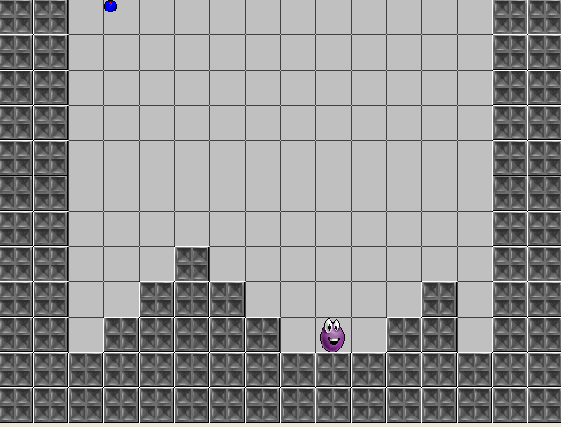
A test environment (cont)
Game Development 1.1
Denis McCarthy

Slide 55
Time to test our progress
At last, you can finally test the game!
Test the characters movement in all possible situations and make sure that he behaves the way you would expect.
If something isn’t working right:
  Then check your steps carefully
  Making sure that you enabled the Relative option in all the actions where it was indicated.
Next we must create falling boxes.
Game Development 1.1
Denis McCarthy

Slide 56
Falling Boxes
Our next goal is to create the falling boxes that both threaten the player and provide the means for their escape.
As indicated in the game description, there will be four types of boxes on the game:
  Stone
  Metal
  Wooden
  Cardboard
As you would expect, stone boxes are the heaviest and cardboard boxes are the lightest.
Falling boxes are chosen at random and heavier boxes will crush lighter boxes as they fall – making it harder to build a stairway out of the pit.
However, to give the player a chance to think ahead, the next box will be shown in the corner of the screen while the last box is still falling.
Game Development 1.1
Denis McCarthy

Slide 57
Falling Boxes (cont)
Each box will need to change its behaviour three times in the game:
  It appears in the corner, as the “next box”
  Then it falls down the screen until it lands on another box.
  And finally it forms a stationary obstacle for Lazarus to negotiate.
If you haven’t already guessed, we will achieve this by creating three different objects for each box: one for each behaviour.
We will start by creating the stationary boxes, as they are the simplest to make.
First, though, we need to create some new sprites.
Game Development 1.1
Denis McCarthy

Slide 58
Stationary Boxes
Create sprites called sprite_box_stone and sprite_box_card using StoneBox.gif and CardBox.gif. Disable the Remove Background option on both of these sprites.
Create sprites called sprite_box_metal and sprite_box_wood using MetalBox.gif and WoodBox.gif. This time leave the Remove Background option enabled, as these two sprites have a small amount of transparency around the edges.
Create a new object called object_box_stone and give it the sprite for the stone box. Set the Solid option so that it is detected in collision tests.
Repeat the previous steps to add objects for object_box_card, object_box_metal and object_box_wood.
Game Development 1.1
Denis McCarthy

Slide 59
Falling Boxes (cont)
Next we’ll make the falling boxes.
These need to start at the top of the screen, directly above Lazarus’s horizontal position, so we’ll make use of the x variable of the standing Lazarus object to tell us where that is.
Once it starts falling, we’ll give it a speed of 5 because that divides exactly into 40 (important for the same reason as before.
It is slightly slower than the speed Lazarus falls (otherwise a box might squish Lazarus in the air!).
When a box collides with a heavier box, it turns into a stationary box.
When it collides with a lighter box, it destroys that box and continues to fall.
Game Development 1.1
Denis McCarthy

Slide 60
Creating falling stone box
Create a new object called object_falling_stone, give it the sprite for the stone box, and select the Solid option as before.
Add a Create event and include a Jump to Position action in it. Type the variable object_laz_stand.x (the horizontal position of Lazarus) into X and set Y to -40. This will make the box start above Lazarus, just out of view at the top of the screen.
Next include the Move Fixed action, using a downward direction and a Speed of 5.
Add a Collision event with object_laz_stand and include a Change Instance action in it. Change the Applies to option to Other, so that it changes Lazarus rather than the box. Select the object_laz_squished and select yes to Perform Events.
Game Development 1.1
Denis McCarthy

Slide 61
Creating falling stone box (cont)
Add another Collision event, this time with object_wall. This needs to stop the box moving, so include a Move Fixed action and select the middle square with a Speed of 0. Also include a Change Instance action, and select the stationary box object_box_stone.
Add a third Collision event with object_box_stone and include the same two actions as the Collision event with the wall above (you could copy them!).
Add a fourth Collision event with object_box_metal. The metal box is lighter than the stone box so it must be crushed. Include a Destroy Instance action and select the Other object.
Add fifth and sixth Collision events with object_box_wood and object_box_card, both including identical Destroy Instance actions as we did in step 7 to destroy Other box in the collision.
Game Development 1.1
Denis McCarthy

Slide 62
More falling boxes
Okay, that’s one of the falling boxes. The other falling boxes are similar but need to behave slightly differently when they collide with different kinds of boxes.
Create the remaining three falling objects for the other types (object_falling_metal, object_falling_wood and object_falling_card). Repeat steps 1 – 8 for each one, using step 7 when a box crushes another box and step 5 when a box stops moving. Refer to the table below when deciding which boxes should crush each other.
Materials | Material(s) That it crushes
Stone | Metal, Wood and Card
Metal | Wood and Card
Wood | Card
Card | None
Game Development 1.1
Denis McCarthy

Slide 63
Phew!
That was quite a lot of work (28 events and 46 actions), made worse by the fact that we had to repeat the same steps over and over again.
Later, we will see there is actually a quicker way to do this kind of thing using parents.
Although this might have seemed like a lot of effort, it may help you to appreciate the work that goes into a commercial game.
They usually take at least 18 months to program and require hundreds of thousands of lines of code to make them work!
Game Development 1.1
Denis McCarthy

Slide 64
Next box
Now let’s set about creating the final set of boxes that appears in the bottom-left corner to show the player which box is coming next.
This adds an important element of game-play, allowing the player to plan ahead and adapt their strategy based on where it would be most useful for the next ball to fall.
It requires quick thinking and takes a bit of practice, but it helps to create a challenging and rewarding game.
The “next box” objects are very simple to make, but we’ll need four of them again – one for each type of box.
Game Development 1.1
Denis McCarthy

Slide 65
Next box objects
Create a new object called object_next_stone, give it a stone box sprite, and enable the Solid option. That’s it, so click OK to close the object properties.
Create objects for object_next_metal, object_next_wood, and object_next_card in the same way.
Game Development 1.1
Denis McCarthy

Slide 66
Main controller object
I’m sure you’ll be relieved to find out that’s all the boxes we need to create for the game!
However, while the falling boxes have actions to turn them into stationary boxes, there are no actions yet for turning next boxes into falling objects, or creating next boxes in the first place.
We are going to use our main controller object to take care of this.
A controller object is usually an invisible object (it doesn’t have a sprite), which performs important actions on other objects.
Our main controller object will use a Step event to continually check if there is a falling box on the level. If not, then it will turn the current next box into a falling box and create a new next box. (Still following?)
In this way, the main controller object will maintain a constant cycle of new falling boxes until the level is completed – or the player gets squished.
Game Development 1.1
Denis McCarthy

Slide 67
Main controller object (cont)
Reopen the properties form for the object_controller_main object by double clicking it in the resource list.
Add a Step, Step event and include the Test Instance Count conditional action (control tab). This counts the number of instances of a particular object on the level and tests it against a value. Choose the object_falling_stone object; leave Number as 0 and Operation as Equal to. This creates a condition that is true if the number of falling stone box instances on the level equal to 0 (i.e. there aren’t any!).
Include three more Test Instance Count conditional actions to check if there are no instances of object_falling_metal, object_falling_wood and object_falling_card in the same way. When combined, these conditional actions will make sure that there are no falling boxes of any kind on the level before creating a new one.
Game Development 1.1
Denis McCarthy

Slide 68
Main controller object (cont)
Include a final Test Instance Count action for the object_laz_stand object, but set Number to 1 and the Operation to Equal to. This makes sure that there is an instance of the standing Lazarus object on the level, rather than any of the other animating objects.
Include a Start Block action. This will group together all the actions that need to be performed to create a new box.
Include a Change Instance action and select Object for Applies to, so that it changes all instances of one kind of object on the level into another. Set Object to object_next_stone, Change into to object_falling_stone, and select yes to perform events (the Create event for the falling box needs to be performed to start it in the correct position). This will turn any stone next boxes into stone falling boxes. This action should look like the next slide.
Game Development 1.1
Denis McCarthy

Slide 69
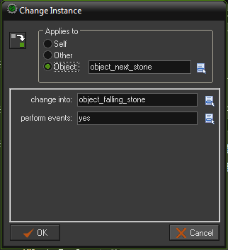
Main controller object (cont)
Game Development 1.1
Denis McCarthy

Slide 70
Main controller object (cont)
However, because the type of will be chosen randomly, we don’t know what kind of next box object the next box will actually be. To cover all bases, add three more Change Instance actions to change object_next_metal objects into object_falling_metal objects, object_next_wood objects into object_falling_wood objects, and object_next_card objects into object_falling_card objects in the same way.
Next we need to randomly create one of the next box objects. Include a Create Random action (main1 tab) and select the four different next box objects. Set X to 0 and Y to 440, and leave Relative disabled. Remember that when Relative is disabled, X and Y are measured from the top-left corner of the screen. These coordinates will therefore put the next new box where it should be in the bottom-left corner of the screen. The action should look like the next slide.
Game Development 1.1
Denis McCarthy

Slide 71
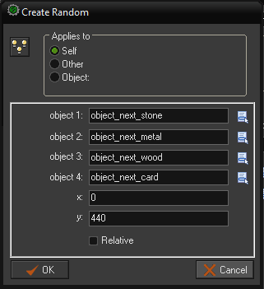
Main controller object (cont)
Game Development 1.1
Denis McCarthy

Slide 72
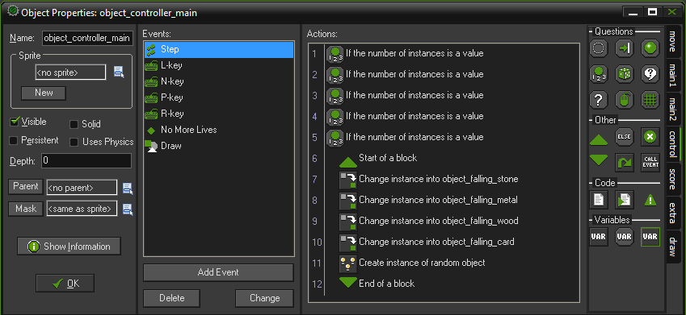
Main controller object (cont)
Finally, include an End Block action to conclude the block of actions that are dependent on all the conditions above them being true.
The set of actions for the Step event should look like below.
Game Development 1.1
Denis McCarthy

Slide 73
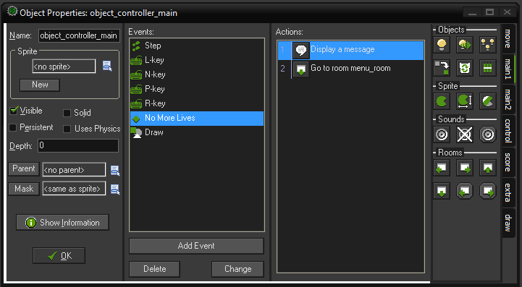
Main controller object (cont)
Last thing we need to is update the No More Lives event, add a Display Message action and set the message to “Game Over!!!”. Make sure this action is before the Different Room action. The completed object should look as follows.
We should have added this last step into our game framework, an oversight on my part.
Game Development 1.1
Denis McCarthy

Slide 74
Lots of actions
This long list of actions means that the block of actions will only be performed if all these conditions are true.
In other words, it there are no instances of object_falling_stone and no instances of object_falling_metal and no instances of object_falling_wood and no instances of object_falling_card and one instance of object_laz_stand, then GM will create a new box.
You might have thought it a bit odd that we need to check that there is a standing Lazarus object as part of our conditions for creating new boxes. If you look back at one of the Jump To Position actions in the Create events of the falling boxes, you will remember that we use the object_laz_stand.x variable to start the object in the correct position.
However, GM can’t provide the object’s x position if it has turned into an animation object, so it will create an error in the program. So to avoid this possibility we check that there’s a standing Lazarus instance on the level before creating new falling boxes.
Game Development 1.1
Denis McCarthy

Slide 75
Testing our falling objects.
Reopen the test room we created by double-clicking on it in the resource list.
Remove all extra wall instances so that it leaves just a pit with walls on both sides and across the bottom. Remove the wall instance in the bottom left hand corner of the room.
We already have a main controller object in place so the creating of new boxes functionality is already in place.
Note: When an object has no sprite, it shows up in the room properties form as a blue ball with a red question mark. This will not appear in the game, but reminds us that this (invisible) object is there when we are editing the room.
Now run the game and test it carefully. Make sure that the box that appears in the bottom-left is actually the box that falls down the screen next and check that heavier boxes are crushing lighter ones.
As usual, if there are any problems, carefully re-check your steps.

Slide 76
Finishing touches
We now have all the basic ingredients of the game in place and there are just a few more things to do before we could call it a finished game.
There’s no way to complete a level yet, so we need to include the stop buttons that will halt the boxes and move the player onto the next level.
Some sound effect would be nice, as would a background to the levels. Implement the scoring system.
We’re obviously going to need a few different levels (this will be your next assignment)
Before all that we gong to add something cool that will endear the player to Lazarus’s plight a little more.
Game Development 1.1
Denis McCarthy

Slide 77
No Way Out!!!
You may have noticed that there’s another animation we haven’t used yet that shows Lazarus looking afraid.
We’re going to show this animation when he’s in a hopeless situation and knows he is about to meet his end.
However, rather than creating a new object for this animation like we did the others, we’re just going to change the sprite of the standing Lazarus object when he becomes afraid.
We can do this because “being afraid” does not need any actions of its own: it has exactly the same behaviour as standing –it just looks different.
We’re going to control this animation within the Step event, so that the correct animation is chosen at any point in time.
Game Development 1.1
Denis McCarthy

Slide 78
No Way Out!!! (cont)
We will use Check Collision actions to detect if Lazarus is surrounded by stacks of boxes two or more high on both sides.
The Check Collision action performs actions only when there is a collision at a particular point.
In this way we can detect whether Lazarus is trapped on all sides and set his animation to afraid.
Game Development 1.1
Denis McCarthy

Slide 79
Detect for being trapped
Re-open the standing Lazarus object and select its Step event, so that you can see the existing actions for this event.
Include the Check Collision action in it (control tab) below the last action in the list. Set X to 40 and Y to 0, and enable the Relative option. This checks for a box to the right of Lazarus.
Include another Check Collision action with X set to 40 and Y set to -40, and the Relative option enabled. This checks for a box diagonally to the right of Lazarus.
Include two more Check Collision actions: one with X set to -40 and Y set to 0, and the other with X set to -40 and Y set to -40. Both should have the Relative option enabled. This checks for boxes left and diagonally to the left of Lazarus.
Finally, include a Change Sprite action, using the “afraid Lazarus” sprite. This will now only happen if the four conditional actions above are true and Lazarus is literally boxed in.
Game Development 1.1
Denis McCarthy

Slide 80
Not all is lost!
Hopeless as this situation may sound, it is actually possible for Lazarus to be saved from this predicament by a heavy block crushing the stack of boxes on one side of him.
If this happens we would like Lazarus to stop being afraid.
We could include conditional actions to check for this happening and change his sprite back to normal.
However, we can achieve the same effect simply by including a Change Sprite action at the very beginning of the list of actions for this event.
Changing into the standing Lazarus sprite by default will make the sprite revert back to normal if he stops being trapped.
Game Development 1.1
Denis McCarthy

Slide 81
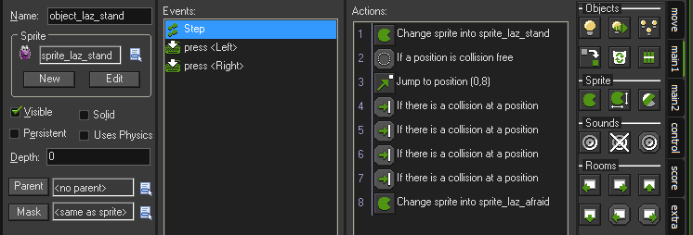
Detect for being freed
Select the Step event for the standing Lazarus object so that you can see the existing actions for this event.
Include a Change Sprite action at the very beginning of the list of actions (you can drag actions about if it fall in the wrong place. Set it to change into the standing Lazarus.
You might want to play the game now and make sure that this new feature is working correctly. Features like this don’t change the game play directly, but add to the playing experience and make the game more entertaining to play.
Game Development 1.1
Denis McCarthy

Slide 82
Adding a Goal
The player’s goal is to reach one of the stop buttons, so that it halts the machinery and stops dropping boxes.
However, in practice all the buttons really need to do is move the player onto the next level when the standing Lazarus object collides with it.
If there are no more rooms we will automatically go to the completed room and add a 1000 to the score for completing the game.
And then the game will restart, albeit at the title screen.
Most of this functionality is already included within our game framework.
Game Development 1.1
Denis McCarthy

Slide 83
Button object resource
Create a new sprite called sprite_button using Button.gif.
Create a new object called object_button and give it the button sprite. Set Depth to 10 so that it appears behind other objects.
Add a Collision event with the standing Lazarus object and include a Set Alarm action in it (main2 tab). Set Step to 10 (a third of a second) and Alarm to Alrarm 0 . This should give a brief pause for the player to realize they have completed the level.
Add an Alarm, Alarm 0 event, this is a good time to insert a score. We will award the player 500 point for completing the level. Make sure the Relative option is enabled. We will look at other ways of scoring within the game soon.
Include a Next Room action (main1 tab).
Edit your test room and add a stop button on either side at the top of the pit. An example of the test room is next.
Game Development 1.1
Denis McCarthy

Slide 84
Object Depth
Depth:
First of all, you can set the Depth of the instances of the object. When
the instances are drawn on the screen they are drawn in order of depth.
Instances with the largest depth are drawn first. Instances with the
smallest depth are drawn last. When instances have the same depth,
they are drawn in the order in which they were created. If you want to
guarantee that an object lies in front of the others give it a negative
depth. If you want to make sure it lies below other instances, give it a
large positive depth. You can also change the depth of an instance
during the game using the variable called depth.
Game Development 1.1
Denis McCarthy

Slide 85
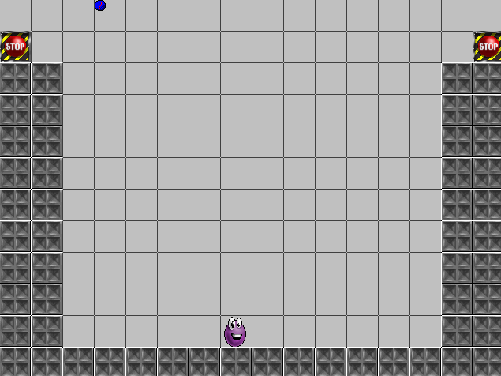
Test room
You may want to place Lazarus beside the stop button for testing purposes.
Game Development 1.1
Denis McCarthy

Slide 86
Scoring System
At the moment, a player gets point for completing a level (500pts) and for finishing the game (1000pts).
Whenever a falling box object is created we will add points to the players score. More point will be given for the stronger material.
  Stone 50pts
  Metal 40pts
  Wood 30pts
  Card 20pts
Re-open the falling stone box object, and select its Create event. To this add a Set Score action, set the Score to 50 and make sure the Relative option is enabled.
Repeat the above step for the metal, wood and card falling objects, giving each their respective score.
Thus the more boxes that are generated, the higher the score.
Game Development 1.1
Denis McCarthy

Slide 87
Sounds
Its about time we made the game feel a bit more professional by including sound effects in the game (the background music is already part of our framework). This is quite simple and you can probably handle most of this on your own by now, but here are some pointers to help you on your way.
Add sound resources for Wall.wav, Crush.wav, Squished.wav, Move.wav and Button.wav if you haven’t already done so and play them at the right times using the Play Sound action.
You’ll need to add crush or wall sound effects to the existing Collision events between falling box objects and stationary box objects. Wall sound when a falling box is changed to a box object and crush sound when an existing box is destroyed.
Adding Create events to play the move sound effects would also be a good way of handling the four moving Lazarus objects.
Game Development 1.1
Denis McCarthy

Slide 88
Sounds (cont)
Finally, you’ll need to play the button sound effect in the Collision event between the button and Lazarus.
Test the game and make sure all of the sounds are playing in the correct place.
If you don’t hear a sound while moving around, check that you set Perform Events to yes in the Change Instance actions that change into animating objects. If you didn’t, then GM won’t perform the Create events that contain the sound effects.
If you haven’t done so already put the background that we used in the title room into our levels.
Game Development 1.1
Denis McCarthy

Slide 89
Game almost complete
At this stage we have added a lot of functionality to the game Lazarus. One thing is missing, Levels.
We only have a test level at the moment, but we need to think of other ways to make interesting levels for the game.
We’ve had no discussion yet on how to design levels, this discussion is for a later stage, but for now the most important points to note about level design, is that you should:
  Build up the difficulty level gradually
  Don’t make it impossible for the player to complete a level.
Without giving you much theory on level design your next assignment will be to create 5 level for this game. (More on this assignment in a moment)
Game Development 1.1
Denis McCarthy

Slide 90
Summary
What did we learn?
  How to create more GM resources
    Origin value for sprites
    Depth of objects on screen
    Game information
  Added new events to objects
    Animation End
  Added new actions to events
    Jump to position
    Change instance
    Check Collision
    Check Empty
    Else
    Test Instance Count
    No more lives
Game Development 1.1
Denis McCarthy

